Slide 1

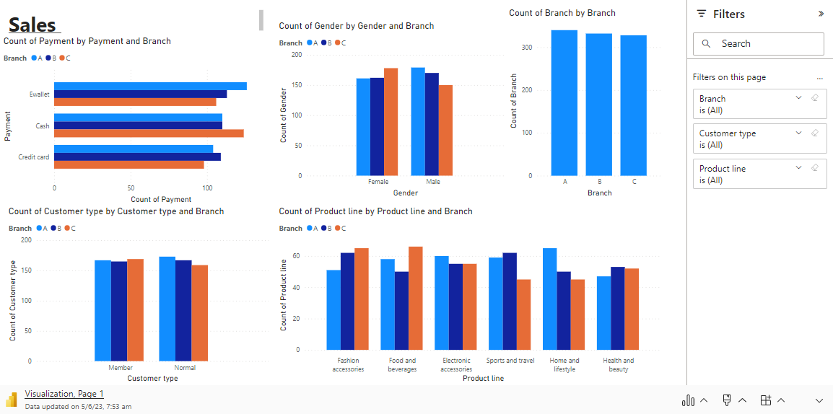
Microsoft Power BI

Slide 2
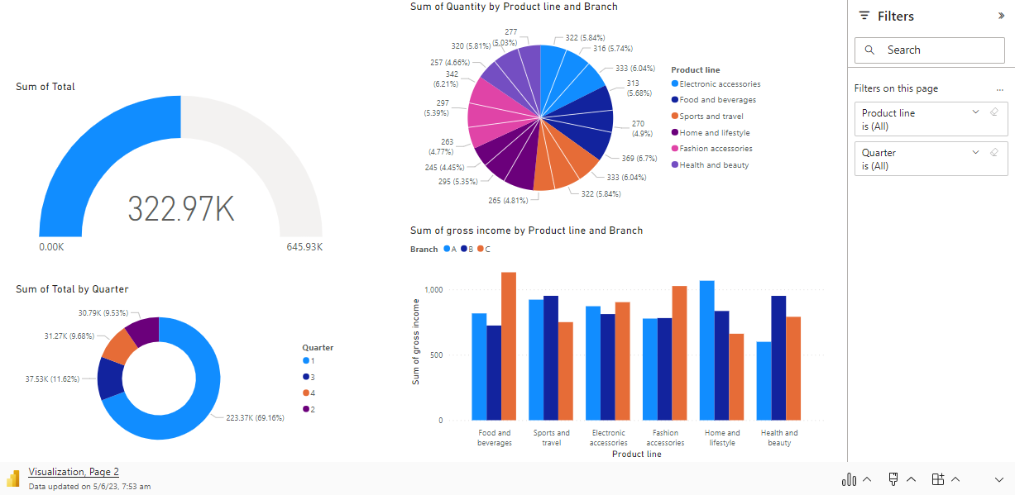
Microsoft Power BI

Slide 3
Data StoryTelling
In the world of retail, there existed a dataset filled with valuable insights waiting to be discovered. Let's embark on a data storytelling journey through the columns of this dataset to unveil the secrets hidden within.
Our story begins with the "Invoice ID" column, which acts as a unique identifier for each transaction. It allows us to track and analyze the purchasing behavior of our customers. As we delve deeper, we encounter the "Branch" and "City" columns, revealing the geographical locations where our stores are situated. By understanding the distribution of branches across different cities, we can identify trends and preferences unique to each region.
Moving forward, we stumble upon the "Customer" column, shedding light on the individuals who bring life to our business. We can segment our customer base, analyze their buying patterns, and personalize our marketing strategies accordingly. Exploring the "Gender" column offers insights into the demographics of our customers, allowing us to target specific audiences effectively.
Next, we encounter the "Product" column, which showcases the diverse range of items we offer. By examining the popularity of different products, we can optimize inventory management and identify opportunities for growth. The "Unit Price" and "Quantity" columns enable us to analyze revenue and sales volumes, guiding us in making informed pricing and stocking decisions.

Slide 4
As our journey continues, we stumble upon the "Tax 5%" and "Total" columns, highlighting the financial aspects of each transaction. By understanding the tax implications and the total revenue generated, we can evaluate profitability and make strategic financial decisions.
The "Date" and "Time" columns introduce us to the temporal dimension of our data. Analyzing sales trends across different time periods allows us to identify seasonality patterns, plan promotions, and optimize resource allocation. The "Payment" column reveals the preferred modes of payment used by our customers, guiding us in providing convenient payment options.
Delving further, we uncover the "COGS" (Cost of Goods Sold) and "Gross Margin" columns. These financial indicators provide us with insights into the profitability of our products. By understanding the cost structure and calculating the gross margin, we can assess the efficiency of our operations and make informed decisions to maximize profitability.
The "Gross Income" column serves as a key performance indicator, representing the total profit generated from sales. Analyzing the trends and fluctuations in gross income allows us to monitor business growth and identify opportunities for improvement.
Lastly, we encounter the "Rating" column, capturing the feedback and satisfaction levels of our customers. By examining customer ratings, we gain insights into the quality of our products and services. Understanding customer sentiments empowers us to enhance customer experiences and foster loyalty.

Slide 5
Throughout our data storytelling journey, we discover that analyzing the dataset's columns - such as invoice ID, branch, city, customer, gender, product, unit price, quantity, tax 5%, total, date, time, payment, COGS, gross margin, gross income, rating, and quarter - uncovers a wealth of knowledge. Armed with these insights, we can make data-driven decisions, optimize operations, and create tailored strategies that drive business success. The power of data storytelling allows us to transform raw data into a compelling narrative, enabling us to unleash the true potential of our business.

